Slide 1
State Planning Office Work Program - update
Continuing to build the
Tasmanian Planning System
State Planning Office
Department of Premier and Cabinet

Slide 2
Continuing to build the Tasmanian planning system
Brian Risby FPIA Director, State Planning Office
I acknowledge and pay respect to the Tasmanian Aboriginal community as the traditional and original owners and continuing custodians of this land.

Slide 3
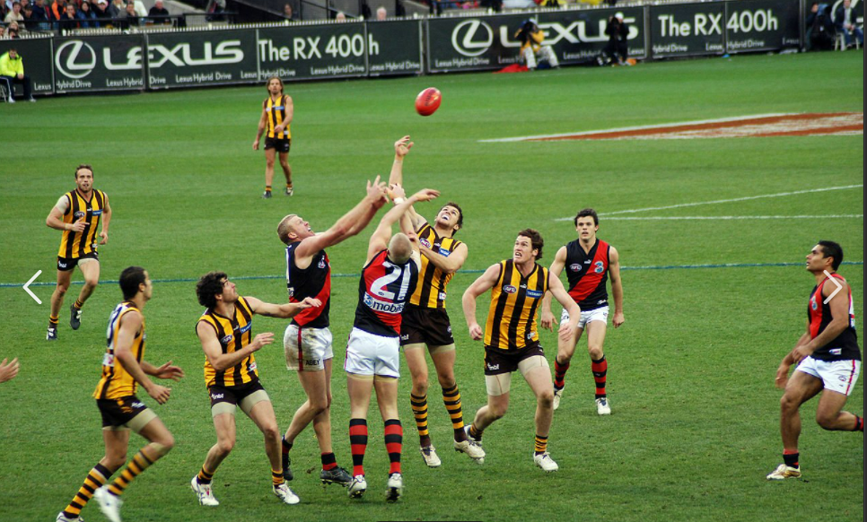
Football?

Slide 4
Cricket?

Slide 5
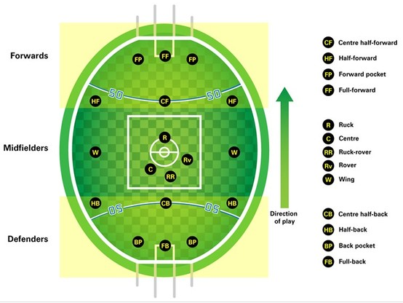
A range of skills in different areas of the field BUT with a common purpose
Teamwork!

Slide 6
The game plan for the next phase of improvements and to highlight opportunities for engagement
Building a better planning system

Slide 7
Planning is about helping to make a better and more sustainable place
This is about how but why and who is important?

Slide 8
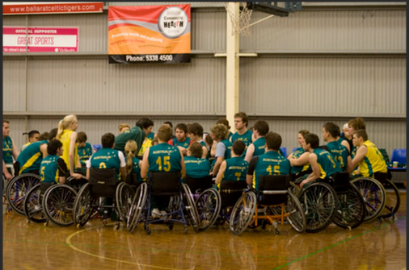
The State Government, local councils, planners and the public all have different parts
We all have roles to play

Slide 9
– the key to successfully building a Tasmanian planning system that is fit for purpose
The ‘game plan’ -
Setting out the key programs and streams of work
Outlining opportunities for engagement
What type of feedback is expected from whom
Where, when and how that feedback will be used
Using teamwork

Slide 10
– more going on means we need good communications
Maintaining the planning system requires a future collaborative effort
Today’s planning reforms make up next year’s planning system
Importance of playing a team position and respecting the roles of others
The State Planning Office’s role is to lead the engagement and ensure the system is properly informed by those driving policy, thinking strategically and working to deliver developments
Continuing to improve communications

Slide 11
Putting planning into the centre of State Government
The old Planning Policy Unit is the new State Planning Office
Now in Dept of Premier and Cabinet (DPAC) – co-located with whole of government policy, Office of Local Government, Office of Security and Emergency Management
Clear separation from Commission, improved links to key policy areas of government agencies
Recognises that the State role in planning is here to stay
Good bye PPU!

Slide 12
“Tell me about the program and the engagement opportunities”
Phase 2 reforms
Tasmanian Planning Policies
Regional Planning framework
leading to -
Comprehensively reviewing the regional land use strategies (RLUSs)
meanwhile – maintenance is underway
Reviewing the State Planning Provisions
Updating urban and regional centre growth strategies
Enough already!

Slide 13
Painting the Sydney Harbour Bridge is basically a constant program
When the planning system is complete it needs regular review

Slide 14
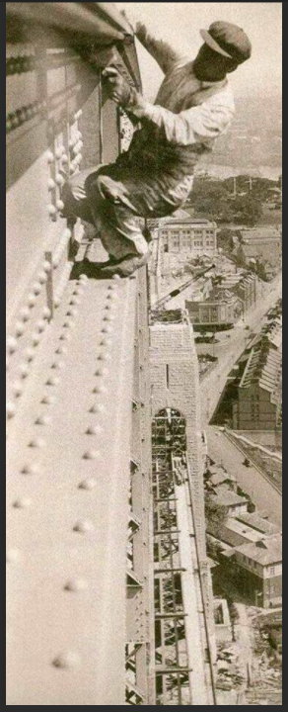
Important the right mechanisms are in place for reviews – the planning legislation provides for this
Do not try this at home!

Slide 15
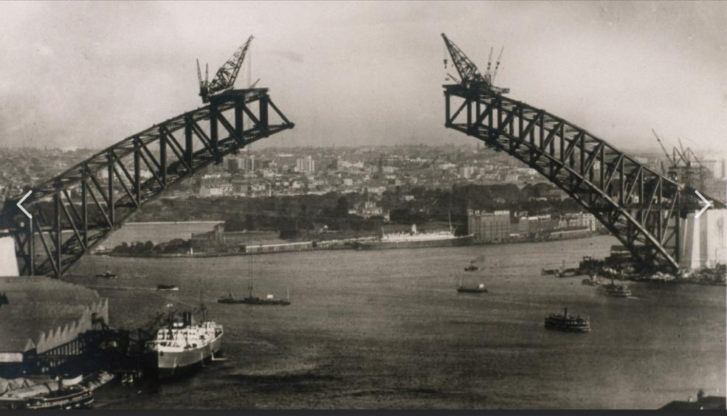
Planning is so much more than a planning scheme – making sure the system works requires coordination and integration
How does it all fit together?

Slide 16
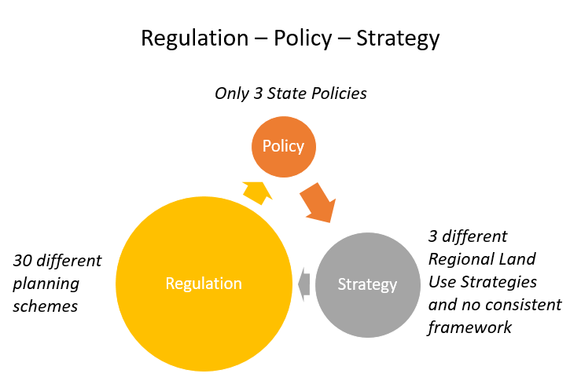
- dominated by regulatory planning with few policies and inconsistent strategies
The planning system in 2013

Slide 17
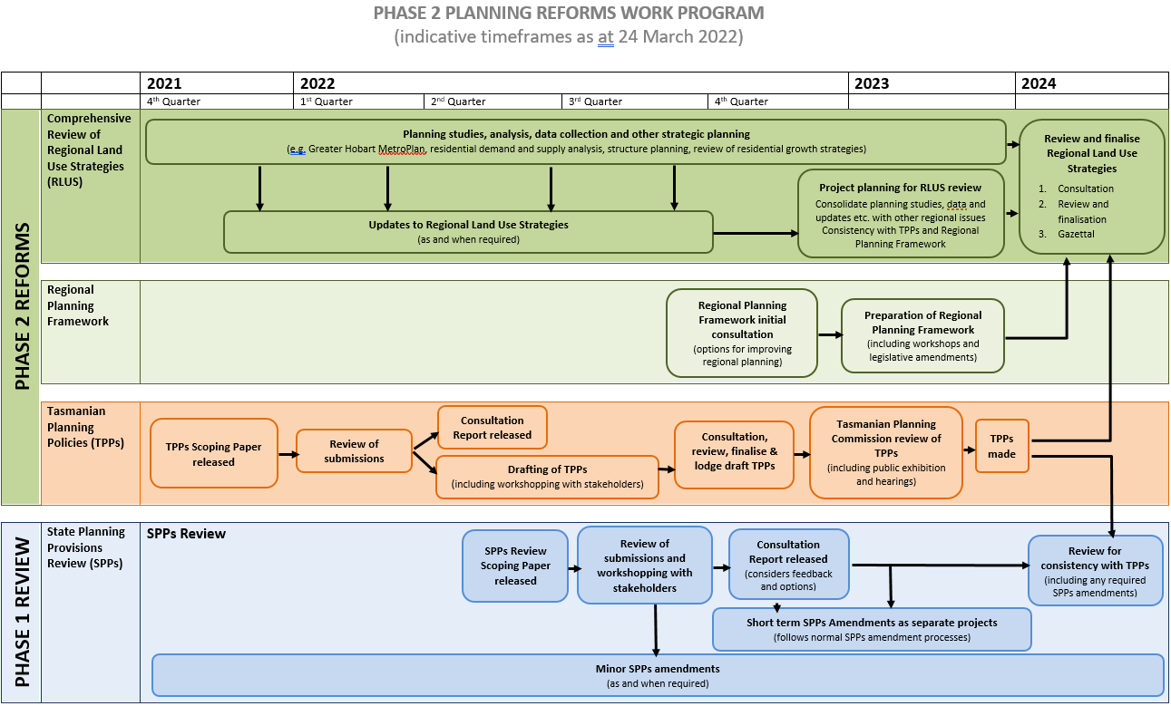
Concurrent work to build a planning policy basis and framework for reviewing the strategies
A program to balance the system

Slide 18
Statutory review of the SPPs – the standardised set of planning rules that councils apply through their Local Provisions Schedules (LPSs)
State Planning Provisions
Step 2:
Consider feedback and provide report on scope
Step 3:
Establish individual projects to address issues and progress SPPs amendments
Step 1:
Scoping process
Apr- Jun 2022
Step 4:
Discussion Paper exploring consistency with TPPs
2023 – after TPPs
------ Jul – Dec 2022 ------
Step 6:
Amendments proposed for consistency with the TPPs
Step 5:
Consider feedback and provide report
------ during 2024 ------
Then a formal independent review by the Tasmanian Planning Commission

Slide 19
Is it too soon to review the SPPs?
some operating for over 2 years
minor amendments made
others need consultation
legislation requires keeping pace with changing needs
Residential standards review (PD 4.1) will be included
Apartment Code development
TPPs require review of the SPPs to ensure alignment
State Planning Provisions review
Who should inform this work? *scoping – public *content - local councils, State agencies and authorities, public *statutory review – public How to get involved - scoping issues - workshopping provisions

Slide 20
Regulation – Policy – Strategy
Only 3 State Policies
Policy
Strategy
Regulation
3 different Regional Land Use Strategies and no consistent framework
One planning scheme with reviewed provisions
Planning reforms and Historic Cultural Heritage

Slide 21
The project is preparing a set of planning policies to guide the other parts of the planning system
The TPPs will provide the Government agency policy input into regional strategies and planning scheme controls
Scoping paper in late 2021
Over 100 submissions
Response report coming soon
Moving to drafting TPPs
Consultation required before consideration by Commission
Formal Commission role
Tasmanian Planning Policies

Slide 22
Who should inform this work? *scoping – public *content - State agencies and authorities *implementation tools - local councils and regional bodies *statutory review – public How to get involved - scoping issues - workshopping implementation
The TPPs will provide Government agency input into regional strategies and planning scheme controls
Tasmanian Planning Policies
Step 2:
Consider feedback and provide report on scope early Apr 2022
Step 3:
Draft with State agencies
Apr – Jun 2022
Step 1:
Scoping process
Step 4:
Workshop implementation of Draft TPPs
Jun 2022
Step 6:
Pre-Commission formal consultation under s.12C of Act (includes Councils and public)
Sept 2022
Step 5:
Finalise draft TPPs for Government approval
Jul 2022
Then a formal independent review by the Tasmanian Planning Commission

Slide 23
Regulation – Policy – Strategy
3 State Policies and set of Tasmanian Planning Policies
Policy
Strategy
Regulation
3 different Regional Land Use Strategies and no consistent framework
One planning scheme with reviewed provisions
Planning reforms and Historic Cultural Heritage

Slide 24
The project will develop a consistent framework for regional planning including preparation, scope, content, timescale, and approval of RLUSs
The 3 Regional Land Use Strategies were prepared without the benefit of a prescribed statewide framework
No formalised governance
Inconsistent in format
Different timescales/ horizons
Variety of approaches to strategic planning (particularly urban growth)
No formal consultation or approval requirements
No review period or process
Regional Planning Framework

Slide 25
Who should inform this work? Everyone should have an interest in developing the framework Regional bodies – key players in preparing strategies Local councils – the LPSs are the primary implementation How to get involved - considering options - workshopping models
The regional planning framework will provide a consistent, robust and inclusive process for the most important strategic plans
Regional Planning Framework
Step 2:
Consider feedback and provide report on options
early 2023
Step 3:
Prepare regional planning framework model
during 2023
Step 1:
Consultation on options for improving regional planning
Aug – Nov 2022
Step 4:
Workshop model
during 2023
Step 6:
Implement through legislative or administrative changes
late 2023
Step 5:
Finalise model for Government approval

Slide 26
Regulation – Policy – Strategy
3 State Policies and set of Tasmanian Planning Policies
Policy
Strategy
Regulation
One planning scheme with reviewed provisions
Consistent framework for preparing Regional Land Use Strategies
Planning reforms and Historic Cultural Heritage

Slide 27
Clear and regular communications are critical for success We will let you know what’s going on….. How to find out - subscribe to Newsletter - check the website - get on the stakeholder list
We understand there is a lot going on!
We’re building a new website
General email address and 1300 number
Feedback is always used
Teamwork is important
Understanding roles and responsibilities
Keep in mind the ‘objective’
Let us know if you need more time
Let us know if you need explanation!
If we all play our parts together we can produce a ‘fit for purpose’ planning system
Improving engagement

Slide 28
Providing project specific engagement strategies Detailed program will be provided to councils Website links
Our website is being further improved to provide project specific information
Purpose of the project
Timelines
The latest news
Information on opportunities to contribute
Details and background documents
Key contacts
Survey about engagement available to help us as a first step
Where to from here?

